Slide 1

The Silent Burden: Uncovering NCD Mortality in the GCC
Capstone Project – General Assembly
Mohamed Alqallaf | Healthcare Data Analyst

Slide 2


What Are Noncommunicable diseases?
NCDs 🧬 | CDs 🦠
Diabetes | COVID-19
Hypertension | Influenza
Cancer | HIV-ADIS

Slide 3
Why Focus on NCDs? 🏥
Noncommunicable diseases cause 50% - 70% of global deaths.
Chronic, preventable, and rising fastest in low-to-middle income regions.
Economic burden expected to exceed USD 47 trillion by 2030

Slide 4
Why the GCC? Why Now? 🐫
Rapid urbanization, lifestyle shifts, high-income populations
Some of the world’s highest obesity and diabetes rates
Youth-dominant demographics at risk of early chronic disease
Governments spending more but not achieving prevention

Slide 5
Bahrain Vision 2030: Health and Resilience🌴
Vision 2030 prioritizes improving quality of life, reducing preventable diseases, and building a sustainable health system.
This project directly supports those goals by identifying policy gaps and opportunities for earlier intervention.

Slide 6
Introduction and Problem Statement📃
Noncommunicable diseases (NCDs) account for nearly half of global deaths. In the GCC, they pose an increasing strain on healthcare systems despite rising investments. This analysis evaluates whether GCC countries, are addressing this burden through preventive strategies aligned with Bahrain Vision 2030’s. Similar national visions across other GCC countries also emphasize long-term health and sustainability.

Slide 7
Aim and Scope 🎯
This project compares GCC NCD mortality patterns with global benchmarks.
It explores mortality data, behavioral risk factors, health spending, and policy coverage.
We focus on the 6 GCC countries, using WHO and World Bank data

Slide 8
Datasets 💾
Primary dataset: WHO Mortality Database ICD-10 (2017-2024)
To count NCD deaths by country, age, sex, and cause
World Bank Population Data (2023)
WHO NCD Country Profiles (2020)
World Bank & OECD Health Spending Data (2021)
Helped compare GCC with global regions
Used to group causes like heart disease, diabetes, and cancer
To calculate deaths per 100,000 people
Helped adjust for country size and make fair comparisons
To show risk factor levels like obesity and diabetes
Helped in getting NCD rates for different countries
Also checked if they have national policies for NCDs
To see how much countries spend on health (% of GDP)

Slide 9
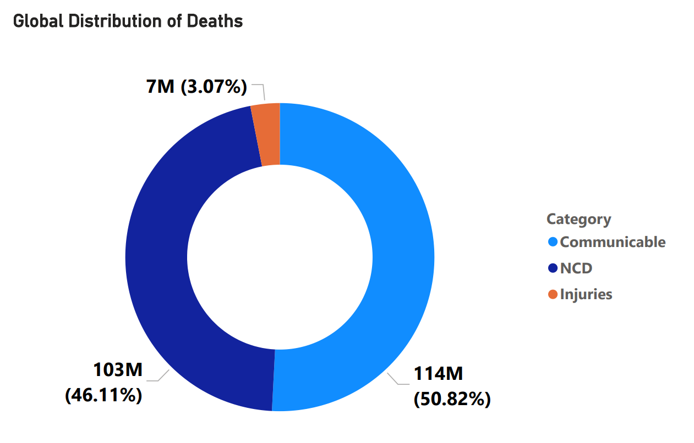
Global Mortality Landscape🌄
Globally, NCDs account for a substantial number of deaths. Understanding their impact across regions highlights the need for effective long-term prevention strategies. COVID-19 caused a shift (~8%)

Slide 10
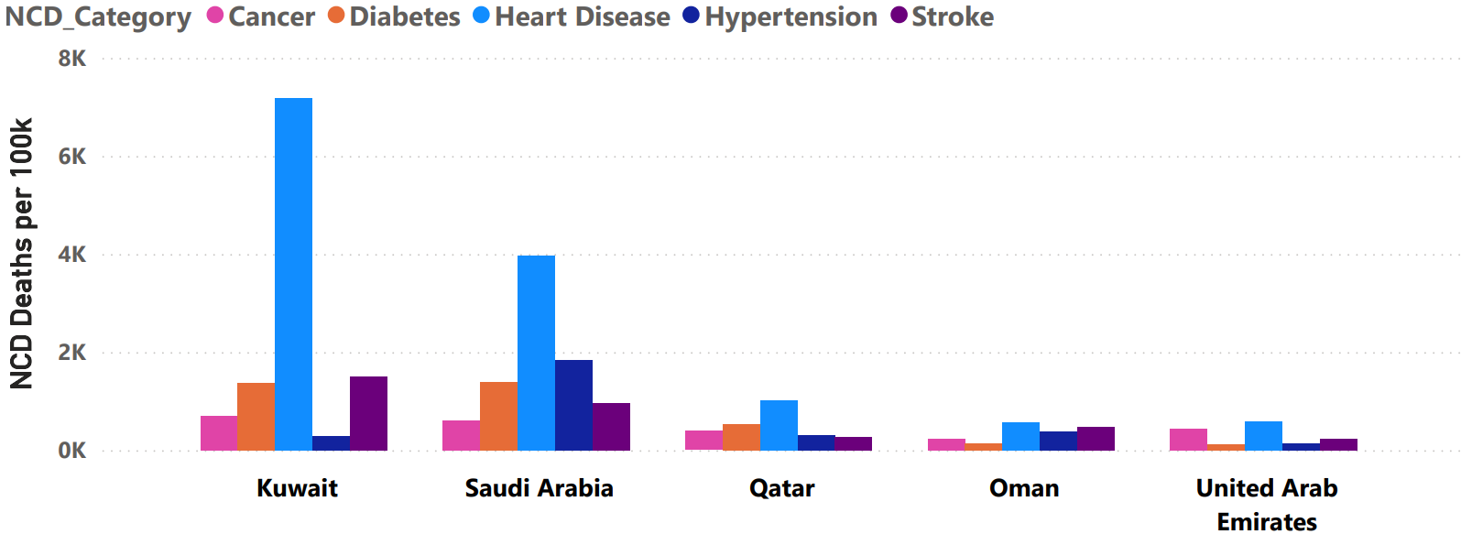
Country-Level Variation in the GCC Deaths💀
Within the GCC, Kuwait, and Saudi Arabia show elevated NCD mortality rates. Cardiovascular disease leads as the top cause, with implications for national productivity.

Slide 11
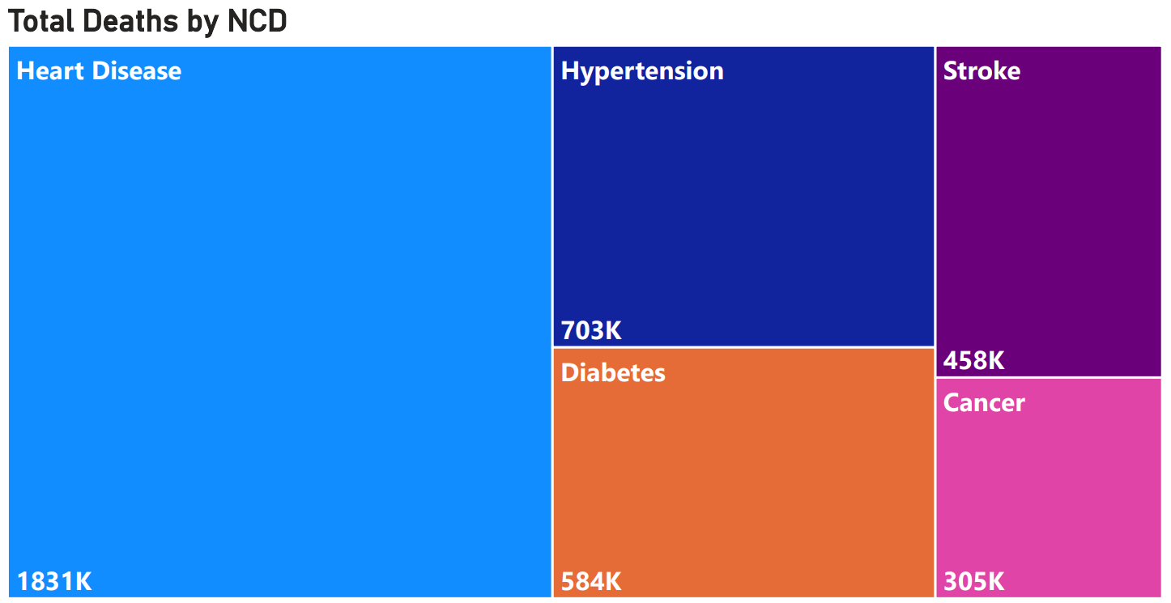
NCD Death category breakdown💀

Slide 12
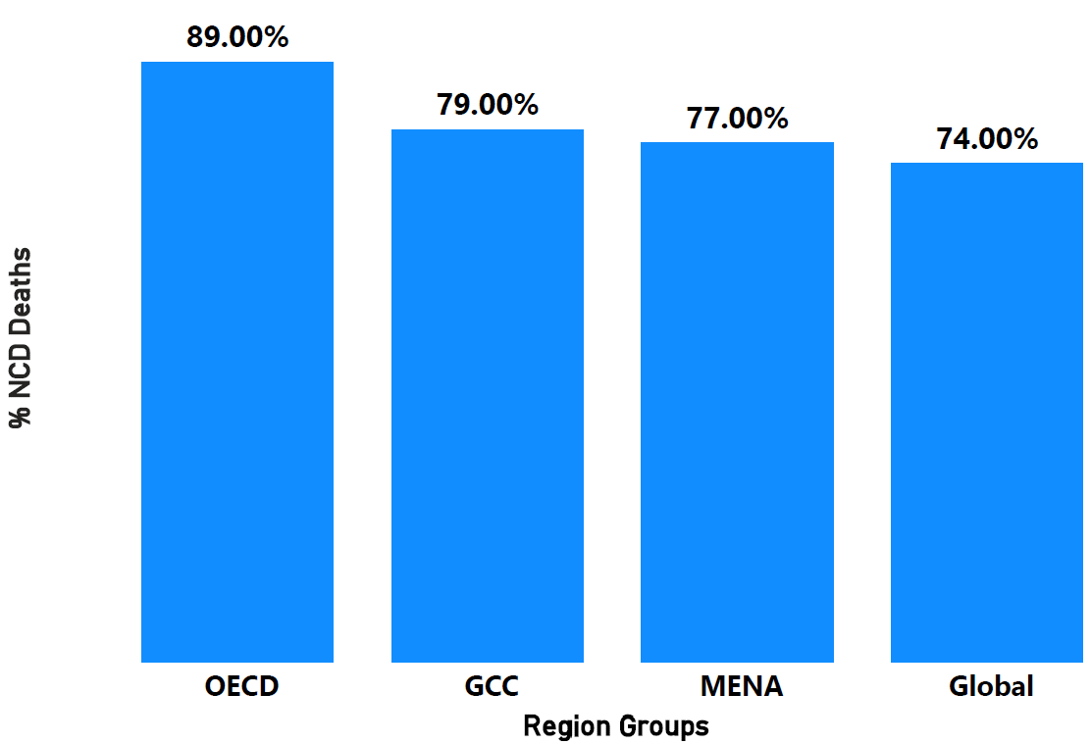
Regional Comparison of NCD Deaths 🌍
The GCC's NCD mortality profile is similar to that of OECD countries but without equivalent preventive outcomes..

Slide 13
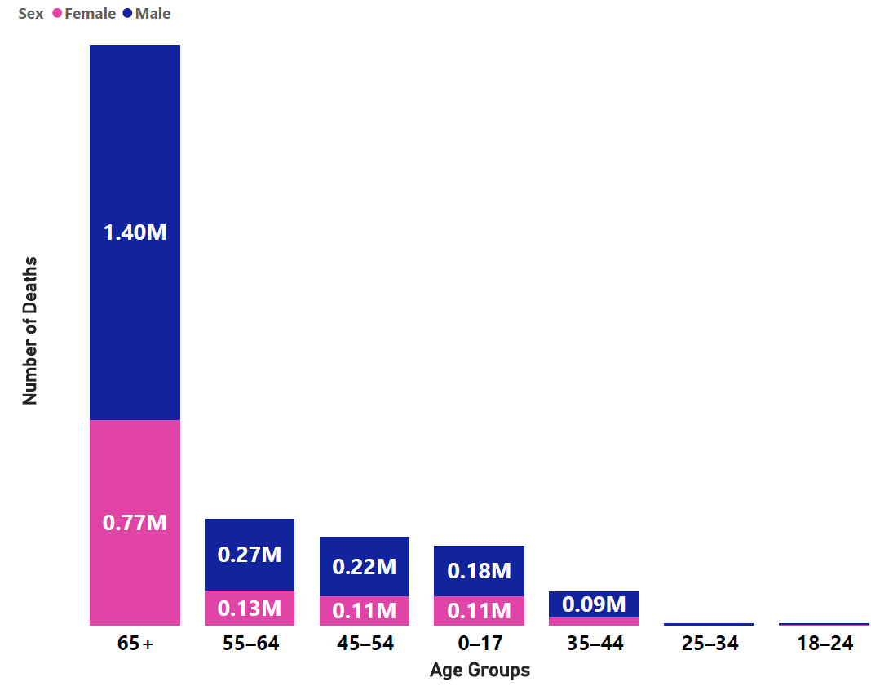
Demographic Insights: Age and Sex 🚹🚺
Men of middle age and older are disproportionately affected by NCDs in the GCC. Early intervention in this demographic supports national labor force sustainability objectives.

Slide 14
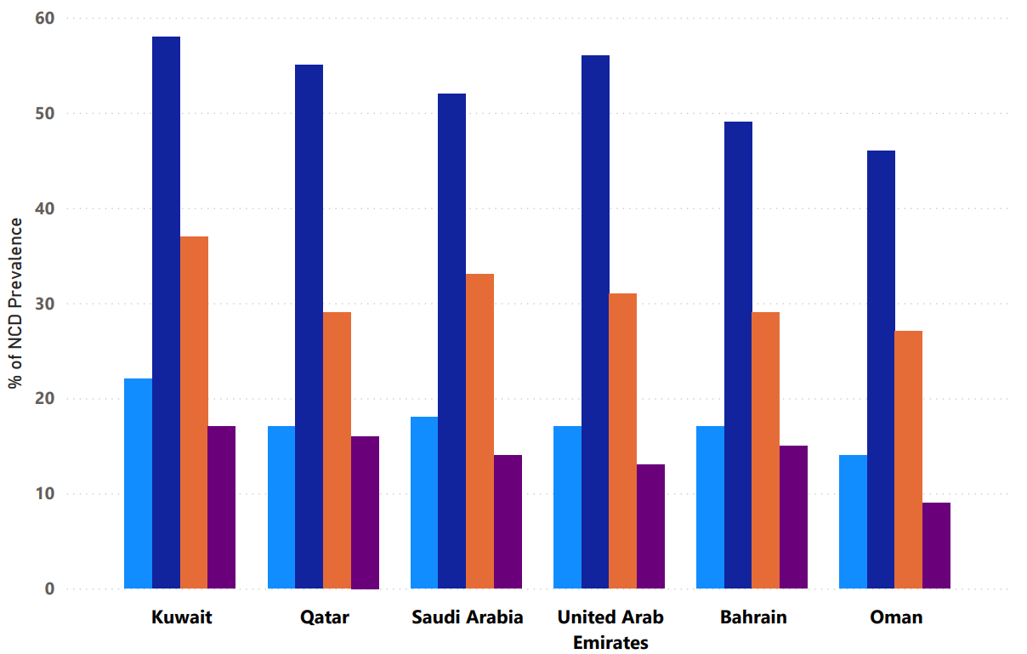
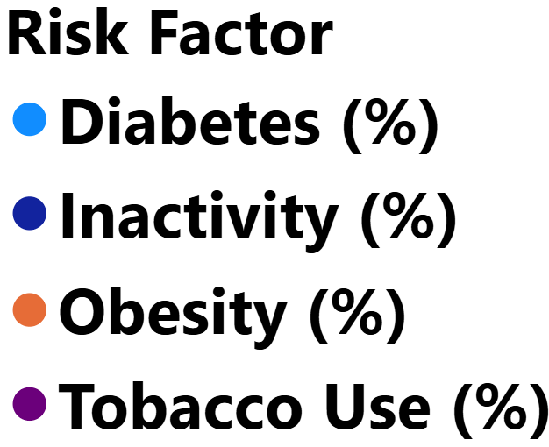




Underlying Risk Factors in the GCC⛔
The GCC has among the world's highest obesity and diabetes rates. But Inactivity is the most prevalent risk factor.

Slide 15
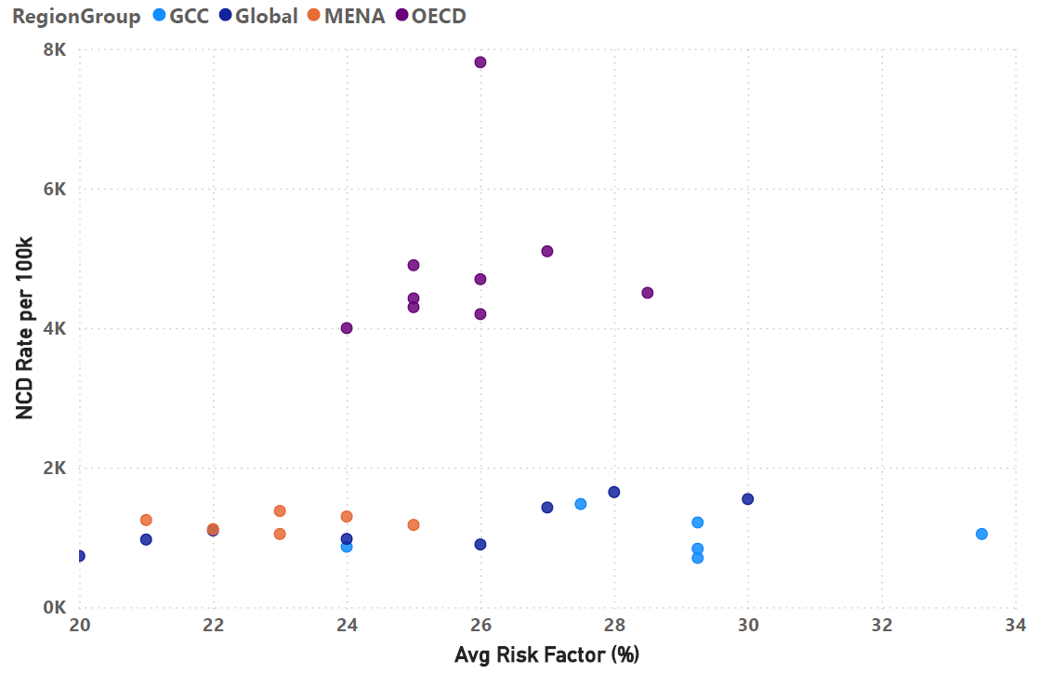
Decoupling Risk from Outcomes 📉
Some countries with high risk factor prevalence report lower-than-expected mortality. This may indicate gaps in screening or reporting, a misalignment Vision 2030 aims to correct.

Slide 16
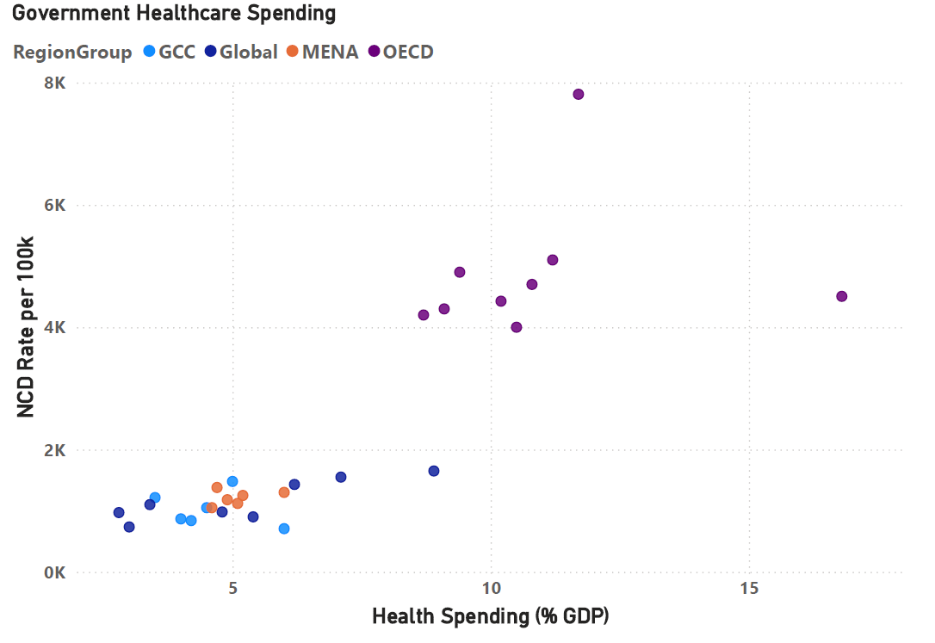
Health Spending versus Health Outcomes💵
Increased spending has not led to proportional reductions in NCD mortality. Strategic investment in prevention is critical to realizing the cost-efficiency targets of Vision 2030.

Slide 17
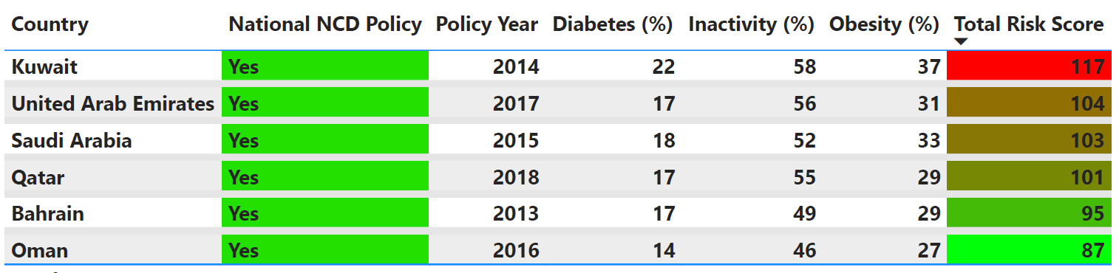
Policy Implementation Gaps📑
Despite policies in place, NCD risk remains high across the GCC. Bahrain Vision 2030 emphasizes actionable implementation to close this gap.

Slide 18
Recommendations ⚖
Expand NCD screening and early detection
Integrate prevention into primary care
Target high-risk age groups through lifestyle programs
Use digital surveillance to track NCD progress
Align health programs with Bahrain Vision 2030 for sustainability and long-term outcomes

Slide 19
Limitations and Future Considerations 🚫
Mortality data not fully age-standardized
Some countries lack comprehensive ICD-10 reporting
Policy impact metrics are inferred rather than measured
Further studies should explore socioeconomic and behavioral risk factors

Slide 20
Thank You
The health of a nation is foundational to its prosperity. Vision 2030's goals will not be met without tackling the silent epidemic of preventable disease.

